Slide 1
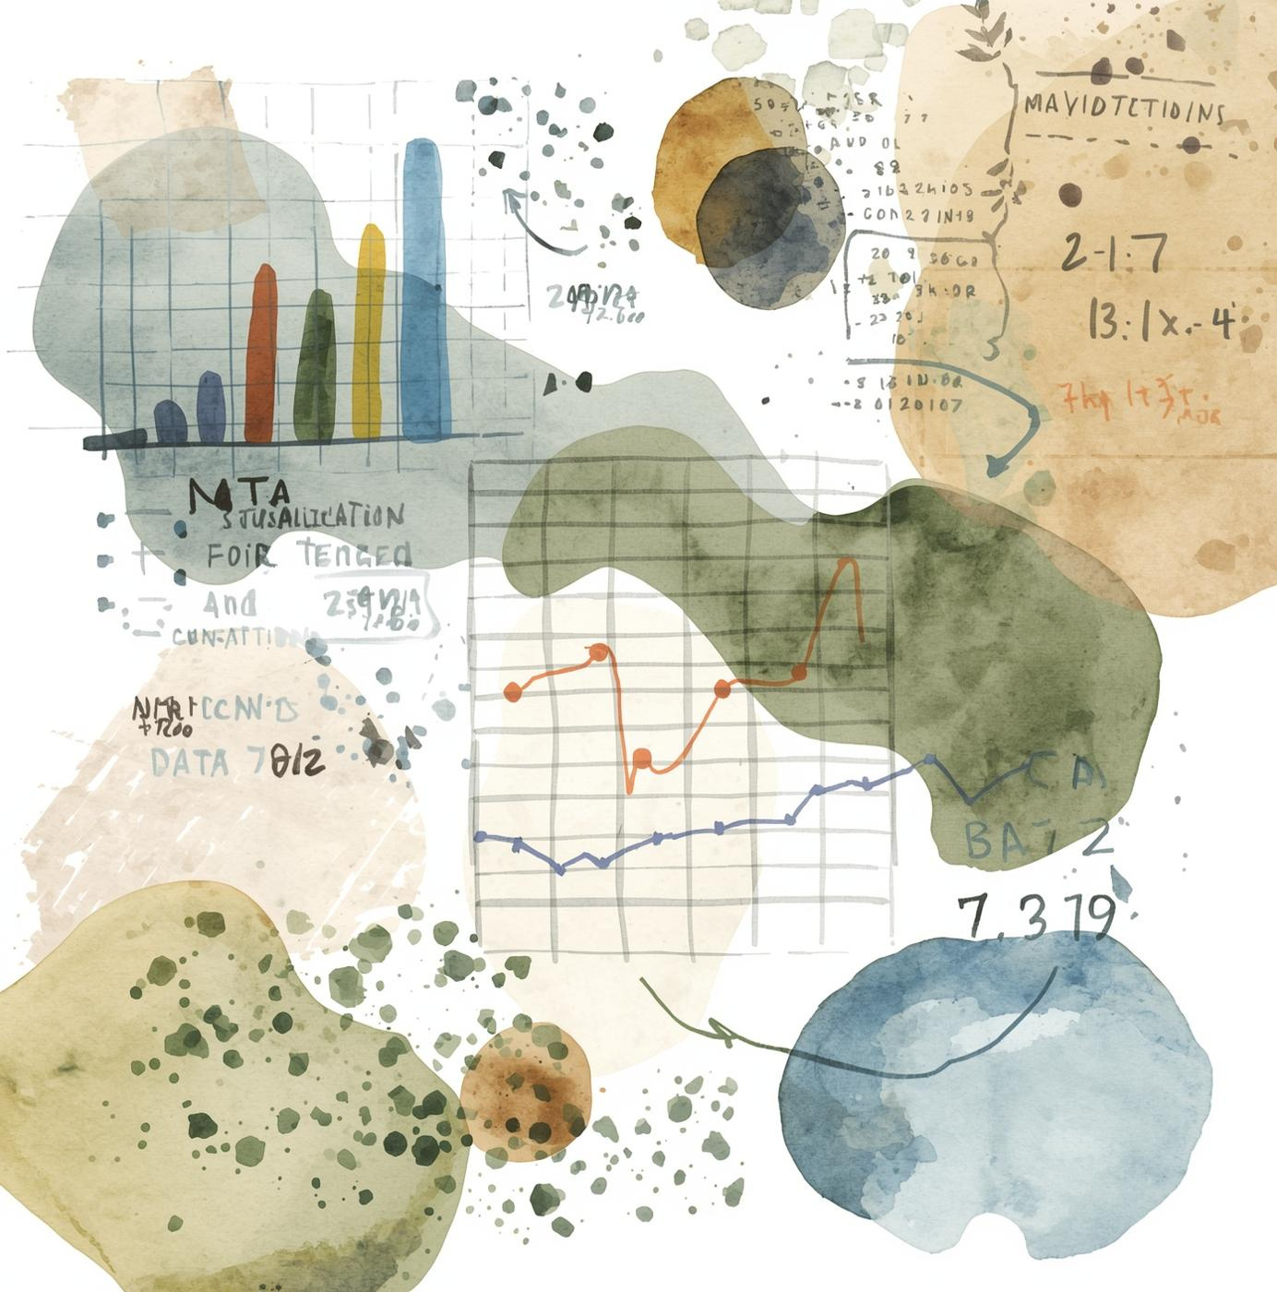
DATA INSIGHTS
Data Visualization: Unlocking Insights Through Visuals
Presented by: [name here], Data Analyst and Visualization Specialist

Slide 2

Introduction to Data Visualization
Data visualization transforms complex data into insightful graphics, enhancing understanding and communication. In professional settings, effective visualization aids decision-making by presenting data clearly and engagingly. This page explores its importance, evolution, and relevance in today's analytics-driven world.

Slide 3

Key Principles
Understanding the core guidelines of effective data visualization is essential for professionals. Emphasizing clarity, accuracy, and storytelling ensures that your visualizations effectively communicate insights and drive informed decision-making while avoiding common pitfalls that can hinder comprehension and engagement.

Slide 4



Choosing the Right Chart Types
01
03
02
Bar
Pie
Effective for comparing quantities across categories.
Useful for displaying proportional relationships among parts.
Line
Ideal for showing trends over a period of time.

Slide 5
Avoiding Common Pitfalls
Misleading Scales
Clutter
Always use proportional scales to ensure accurate interpretation of data trends and comparisons.
Simplify visualizations by removing unnecessary elements, focusing on key information for clearer communication.

Slide 6
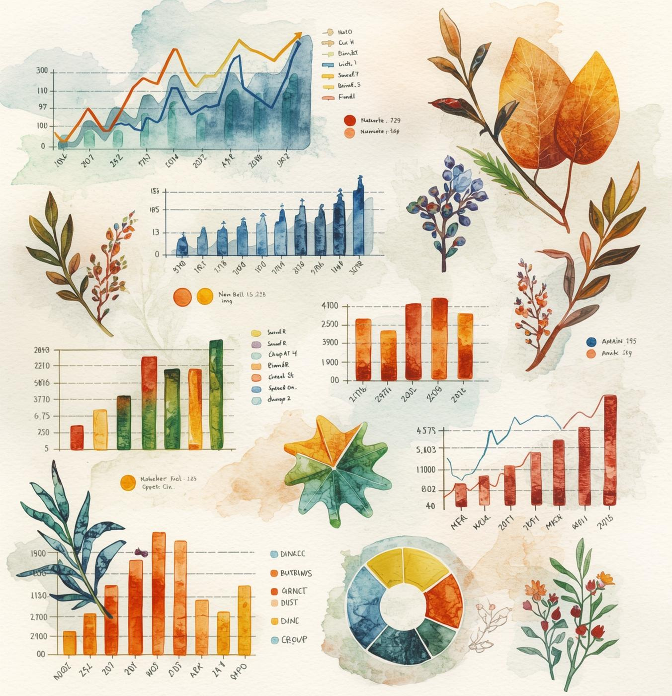
Types and Tools
This section explores various data visualization types and the tools that professionals use to create impactful visualizations. Understanding these options is essential for effectively communicating data insights in a visually appealing and accessible manner.

Slide 7
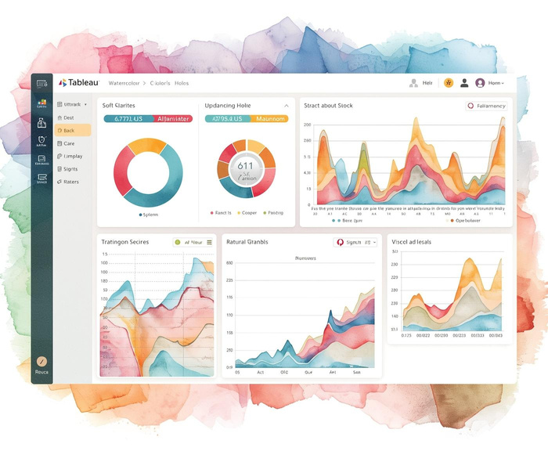

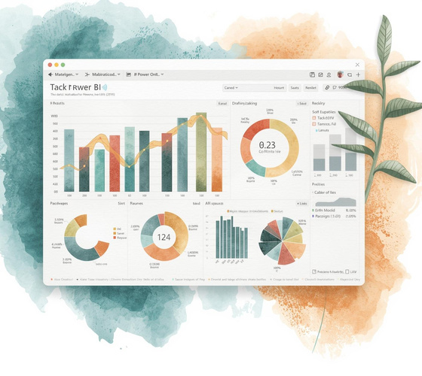
Software and Tools for Visualization
01
03
02
Tableau
D3.js
Powerful tool for interactive data visualization projects.
Flexible library for tailored web-based visualizations.
Power BI
Comprehensive solution for business analytics and reporting.

Slide 8

Conclusion & Next Steps
In summary, data visualization is a vital tool for enhancing communication and decision-making. By embracing key principles and exploring various tools, professionals can elevate their data storytelling, fostering a culture of continuous learning and improvement in their projects.

Slide 9


Get in Touch with Us!
EMAIL
FOLLOW US
PHONE
hello@reallygreatsite.com
@reallygreatsite
123-456-7890

